Slide 1
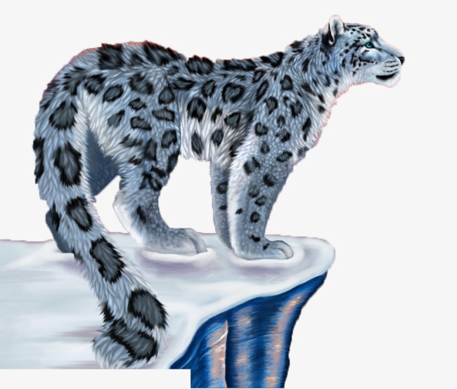
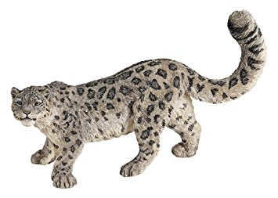
Outside-In
A lesson in positive and negative space

Slide 2
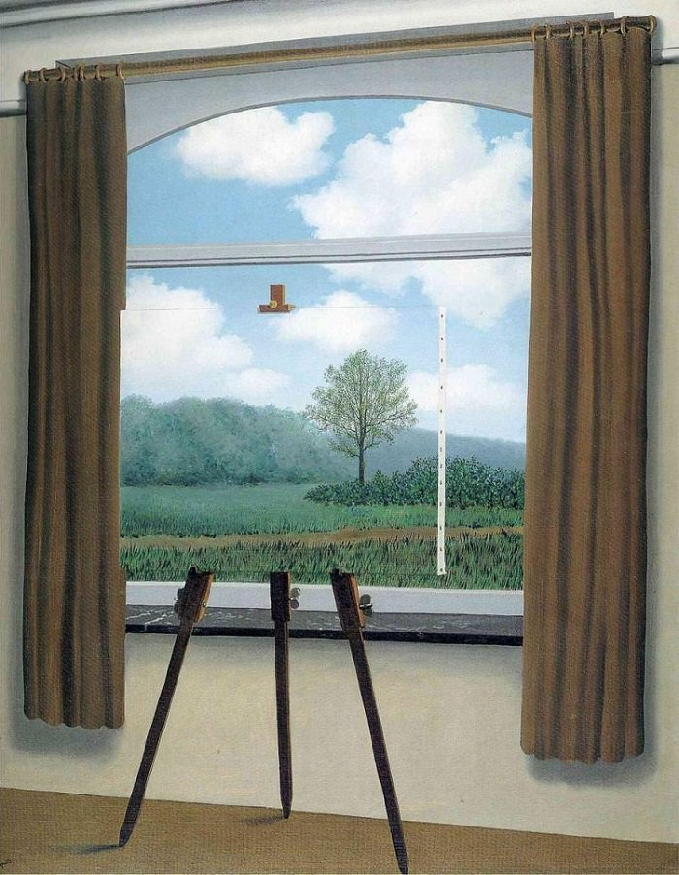
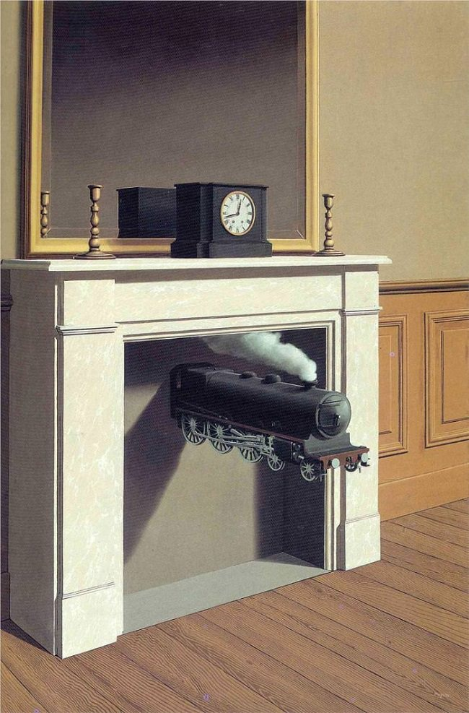
René Magritte
Magritte’s style is known as surrealism, which basically means “beyond real”. He painted ordinary objects but made us look at them in unusual ways. He was able to play tricks on the viewer. Many of his objects look real, but impossible at the same time!
Positive and Negative Space

Slide 3
What is Positive and Negative Space?
Simply put, positive space is the areas in a work of art that are the subjects of the piece. Negative space is area around the subjects.
Take a look at the image.
Do you see 2 faces? Do you see a vase?
If you are seeing a vase, then you are seeing the white area as the positive space. The black areas become the negative space. If you are seeing faces, then you are seeing the black areas as the positive space, and the white area as the negative space.
Notes:
Whichever you see as the subject of the art, that is the positive space.

Slide 4
Examples of uses of positive and negative space...
Balance of Positive and Negative Space…they are pretty equal
Mostly Negative Space …look at all that white space!
Mostly Positive Space…the tree is taking up a lot of room.
Notes:
There are equal amounts of positve (black) and negative (white) space in picture 1. In the center picture, there is mostly negative (white) space. In the last photo, there is mostly positive (black) space.

Slide 5
Notes:
In the example above, ask the children what they are looking at, or what the subject of the piece is. Batman! What color is he? That would be the positive space, and the yellow would be the negative space.

Slide 6
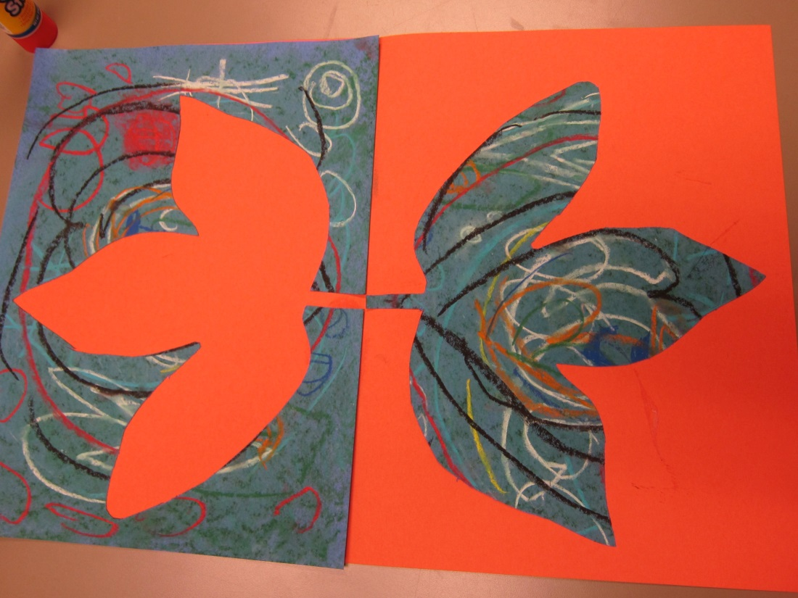
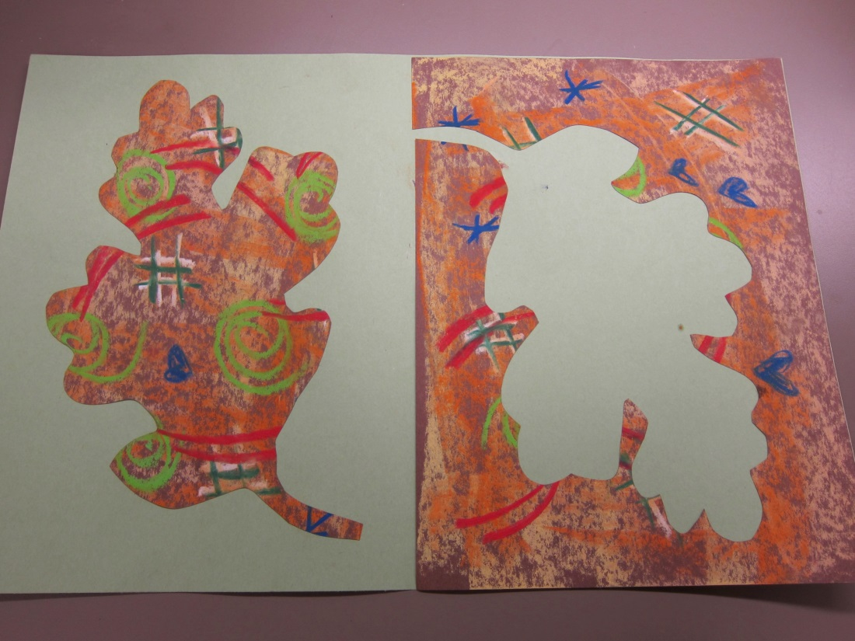
Here are examples of what we are going to make!

Slide 8
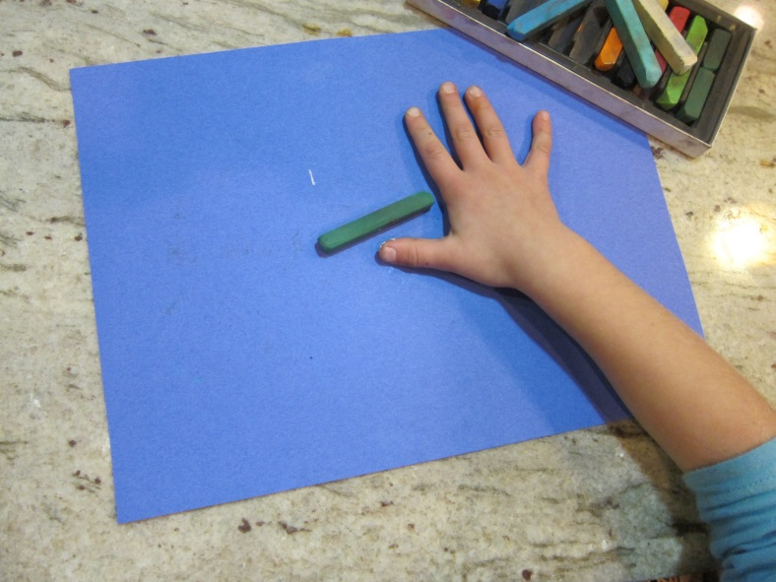
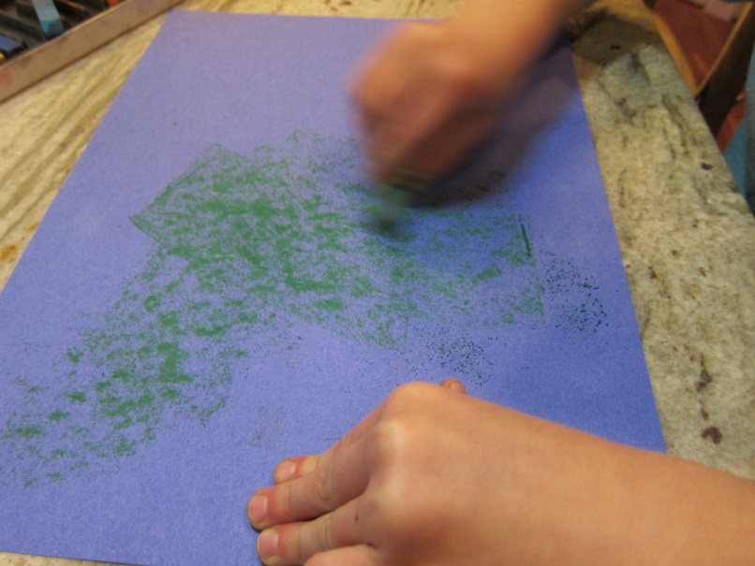
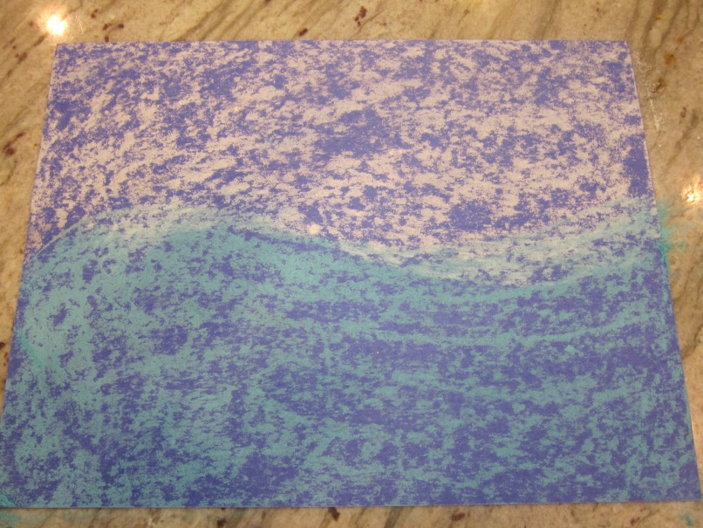
Supplies needed:
Chalk pastels
Scissors,
glue stick,
pencil,
large piece of colored paper,
paper template,
paper towel
Decorate your LARGE colored paper.
Cover your large paper with chalk pastels.
Turn your chalk pastel on its side to get more coverage on your paper.
Be sure to cover the entire paper with color!
Use a crumpled paper towel to blend the colors together.
Notes:
Have children use the chalk pastels on their sides to cover the entire paper.

Slide 9
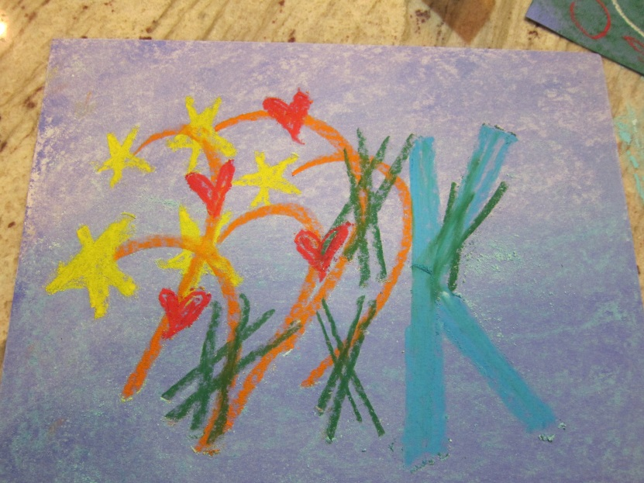
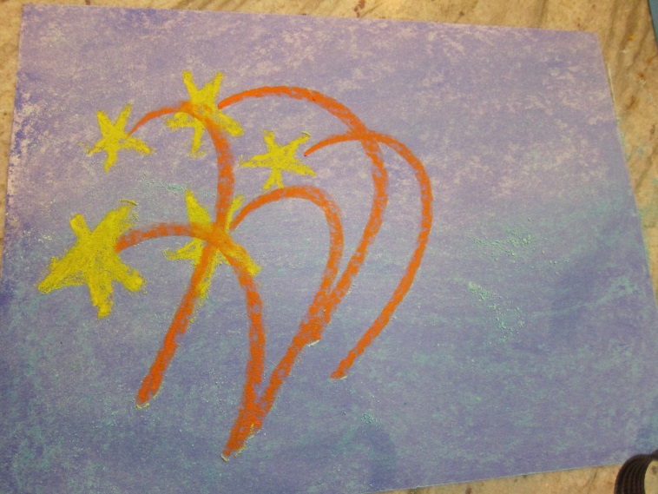
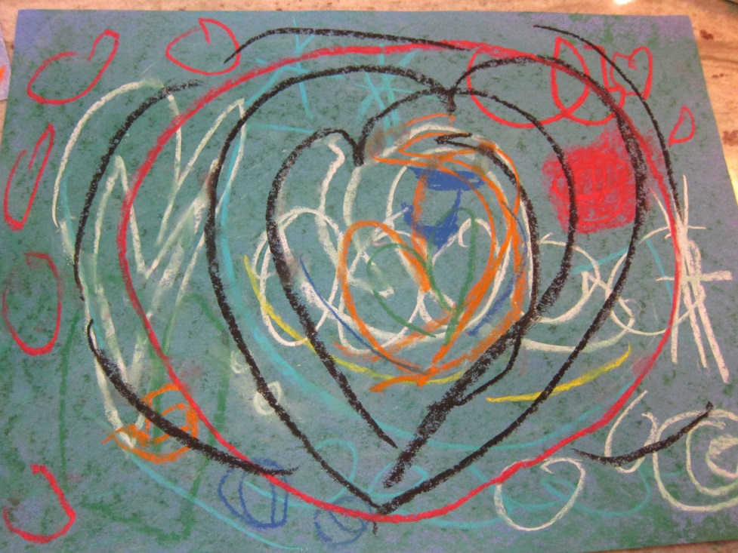
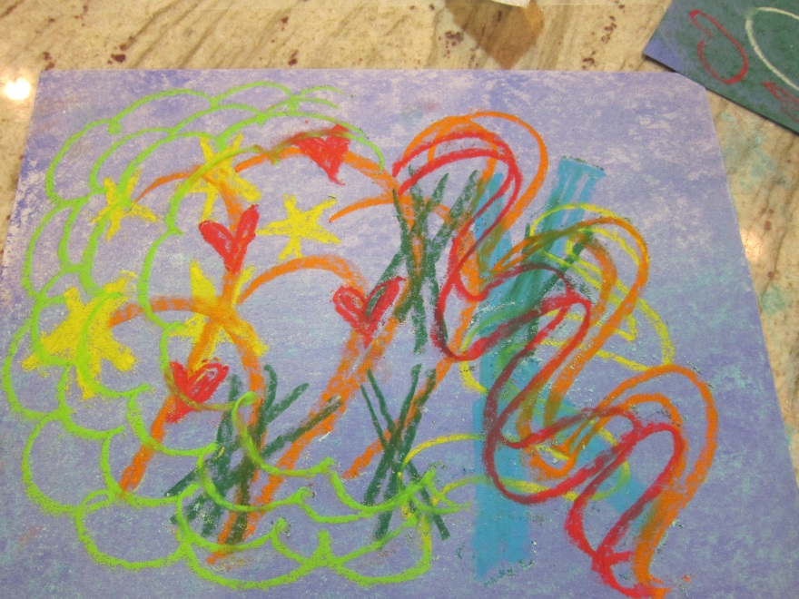
Then make designs, swirls, waves, and shapes, using bold colors. Press hard for the darkest colors. Add patterns and shapes for interest!

Slide 10
Notes:
Examples of background colors and designs

Slide 13
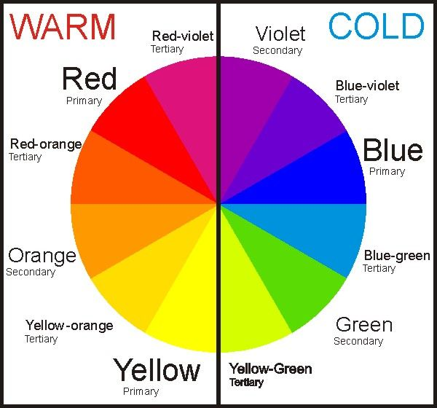
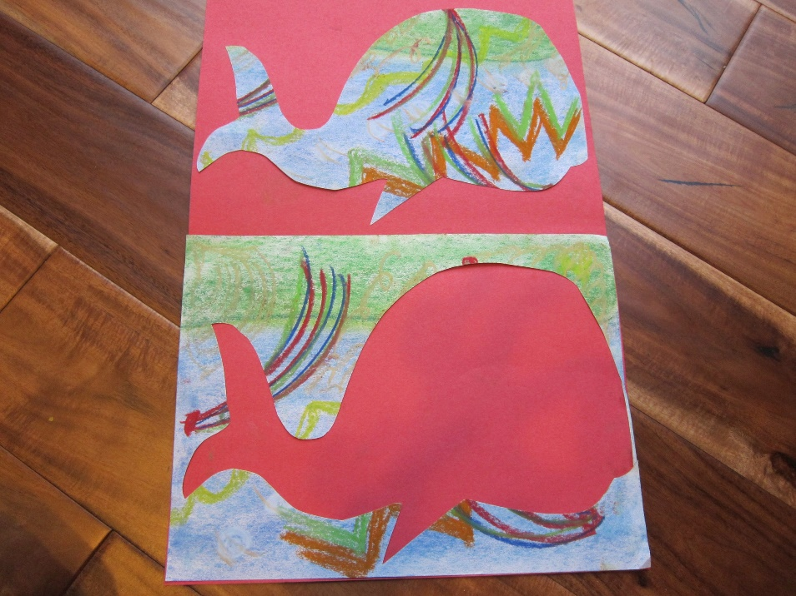
Choose your large background paper. Pick a contrasting color to the chalk pastel piece you created. Look at the color wheel. Pick a color on the opposite side of the wheel from your creature.
Fold your large paper in half like a book.
Set your creature on one side of the fold, and place the scraps on the other side creating a positive and a negative picture of the same subject.
Glue them on! Raise your hand if you need help gluing your scraps on! It can be a two person job!
Notes:
Talk about what Contrasting colors means. Choose a color on the opposite side of the color wheel.

Slide 14
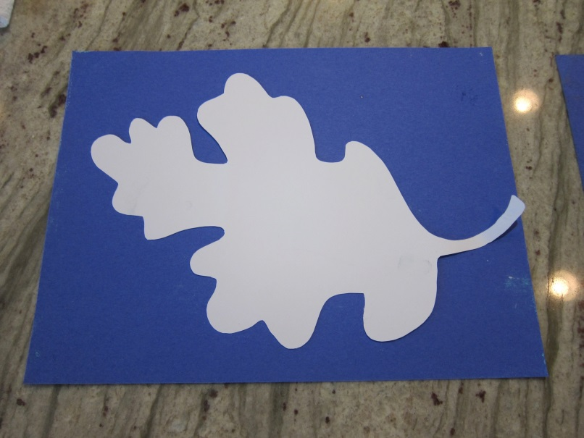
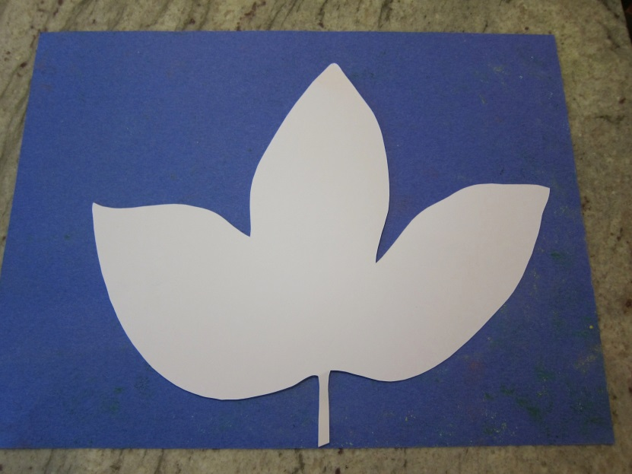
Choose your template. A Template is anything that serves as a pattern or model. Today you can choose different shaped animals.
Trace your animal on a plain piece of paper with a pencil. If you choose a warm color background paper, choose a color from the opposite side, or cool side of the color wheel.
Notes:
I have the children partner up and help hold the template in place while tracing as it can be hard for them to hold and draw.
The whale should have one point of contact on the bottom of the paper with his fin. That is the starting point for cutting to get the best frame for cutting.
The snake should have his tail touching and that is the start of the cutting

Slide 15
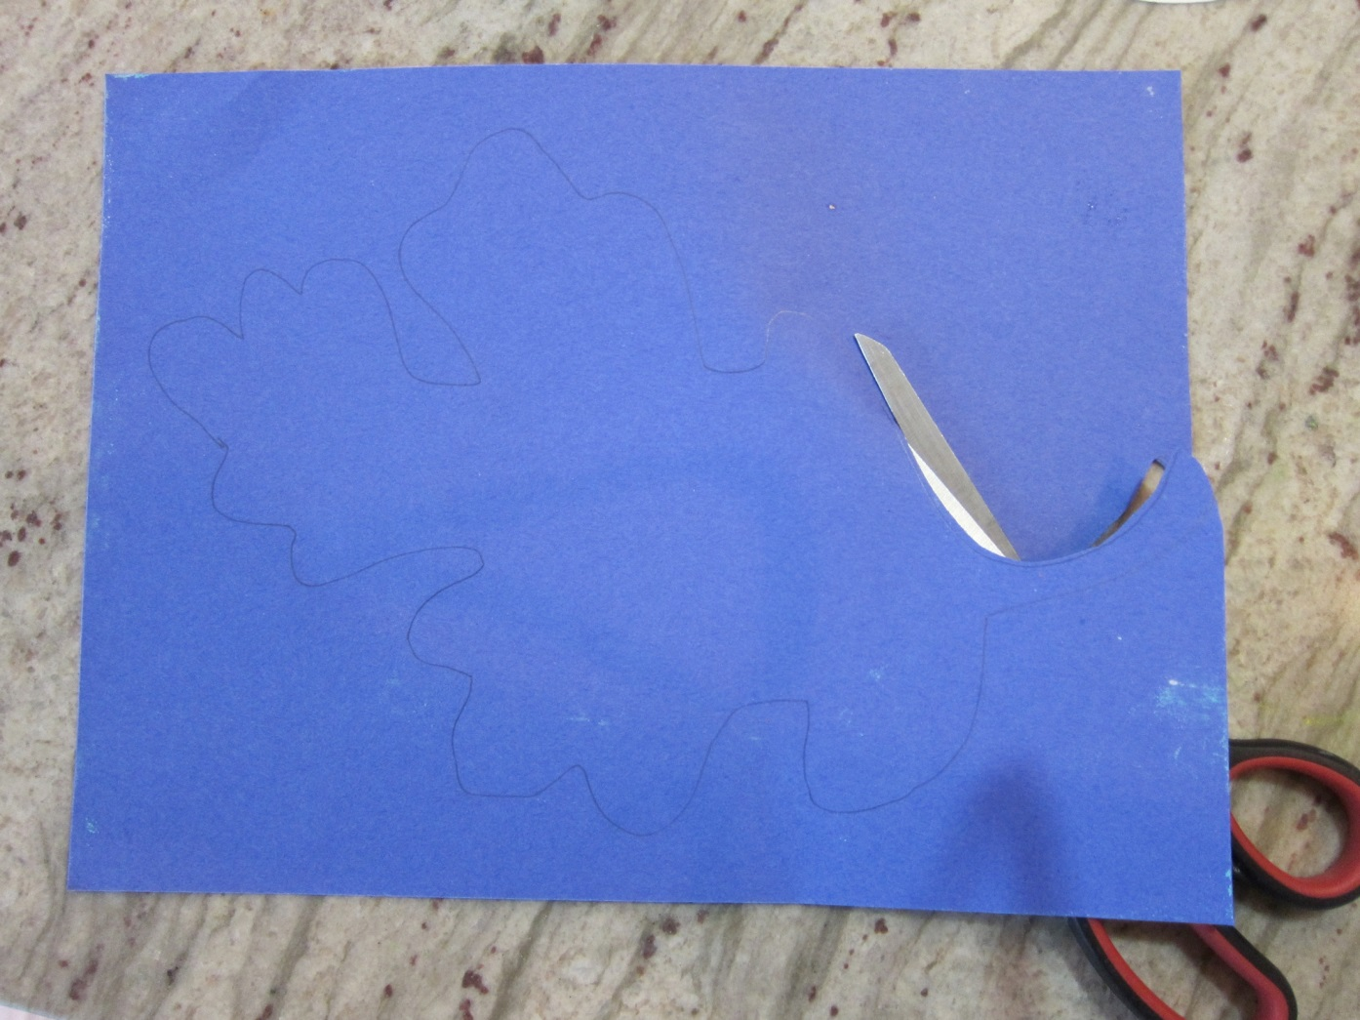
Cut out your picture. Do not cut through your paper off to the side…we want one nice continuous cut. Both pieces will be used in our project, so keep each piece as nice as you can.
When you are finished cutting, place each piece on one side of the large chalked paper.

Slide 16
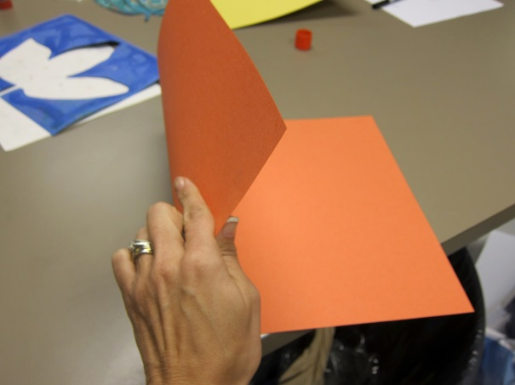
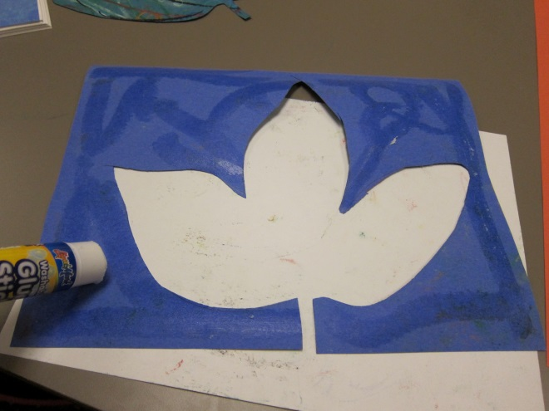
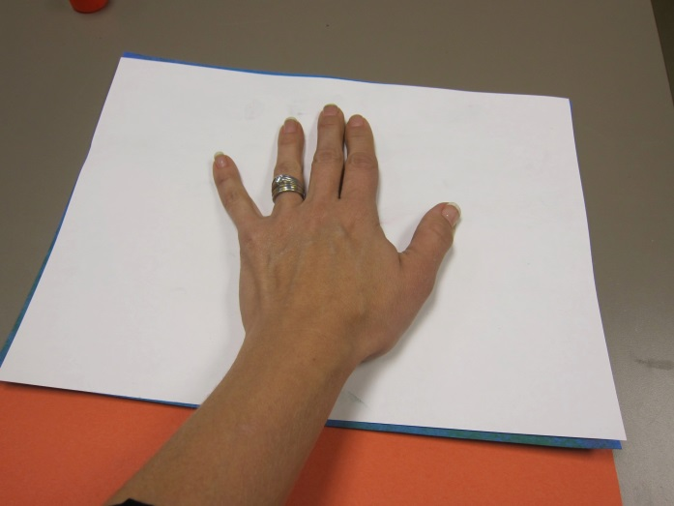
Fold your large paper in half like a book. Open it up and follow the crease marks you made to divide your paper in half.
Set your animal on one side of the fold, and place the outline of the animal on the other side creating a positive and a negative picture of the same subject. Glue them on! Use the white paper to set on top of your chalked art while pressing your glued art down so you don’t smear the chalk and get your hand messy. Raise your hand if you need help gluing your pieces on! It can be a two person job!
Notes:
The white sheet is important so the kids do not smear their chalk. It also helps keep their hands a bit cleaner, and helps get each corner of the piece glued down.

Slide 17
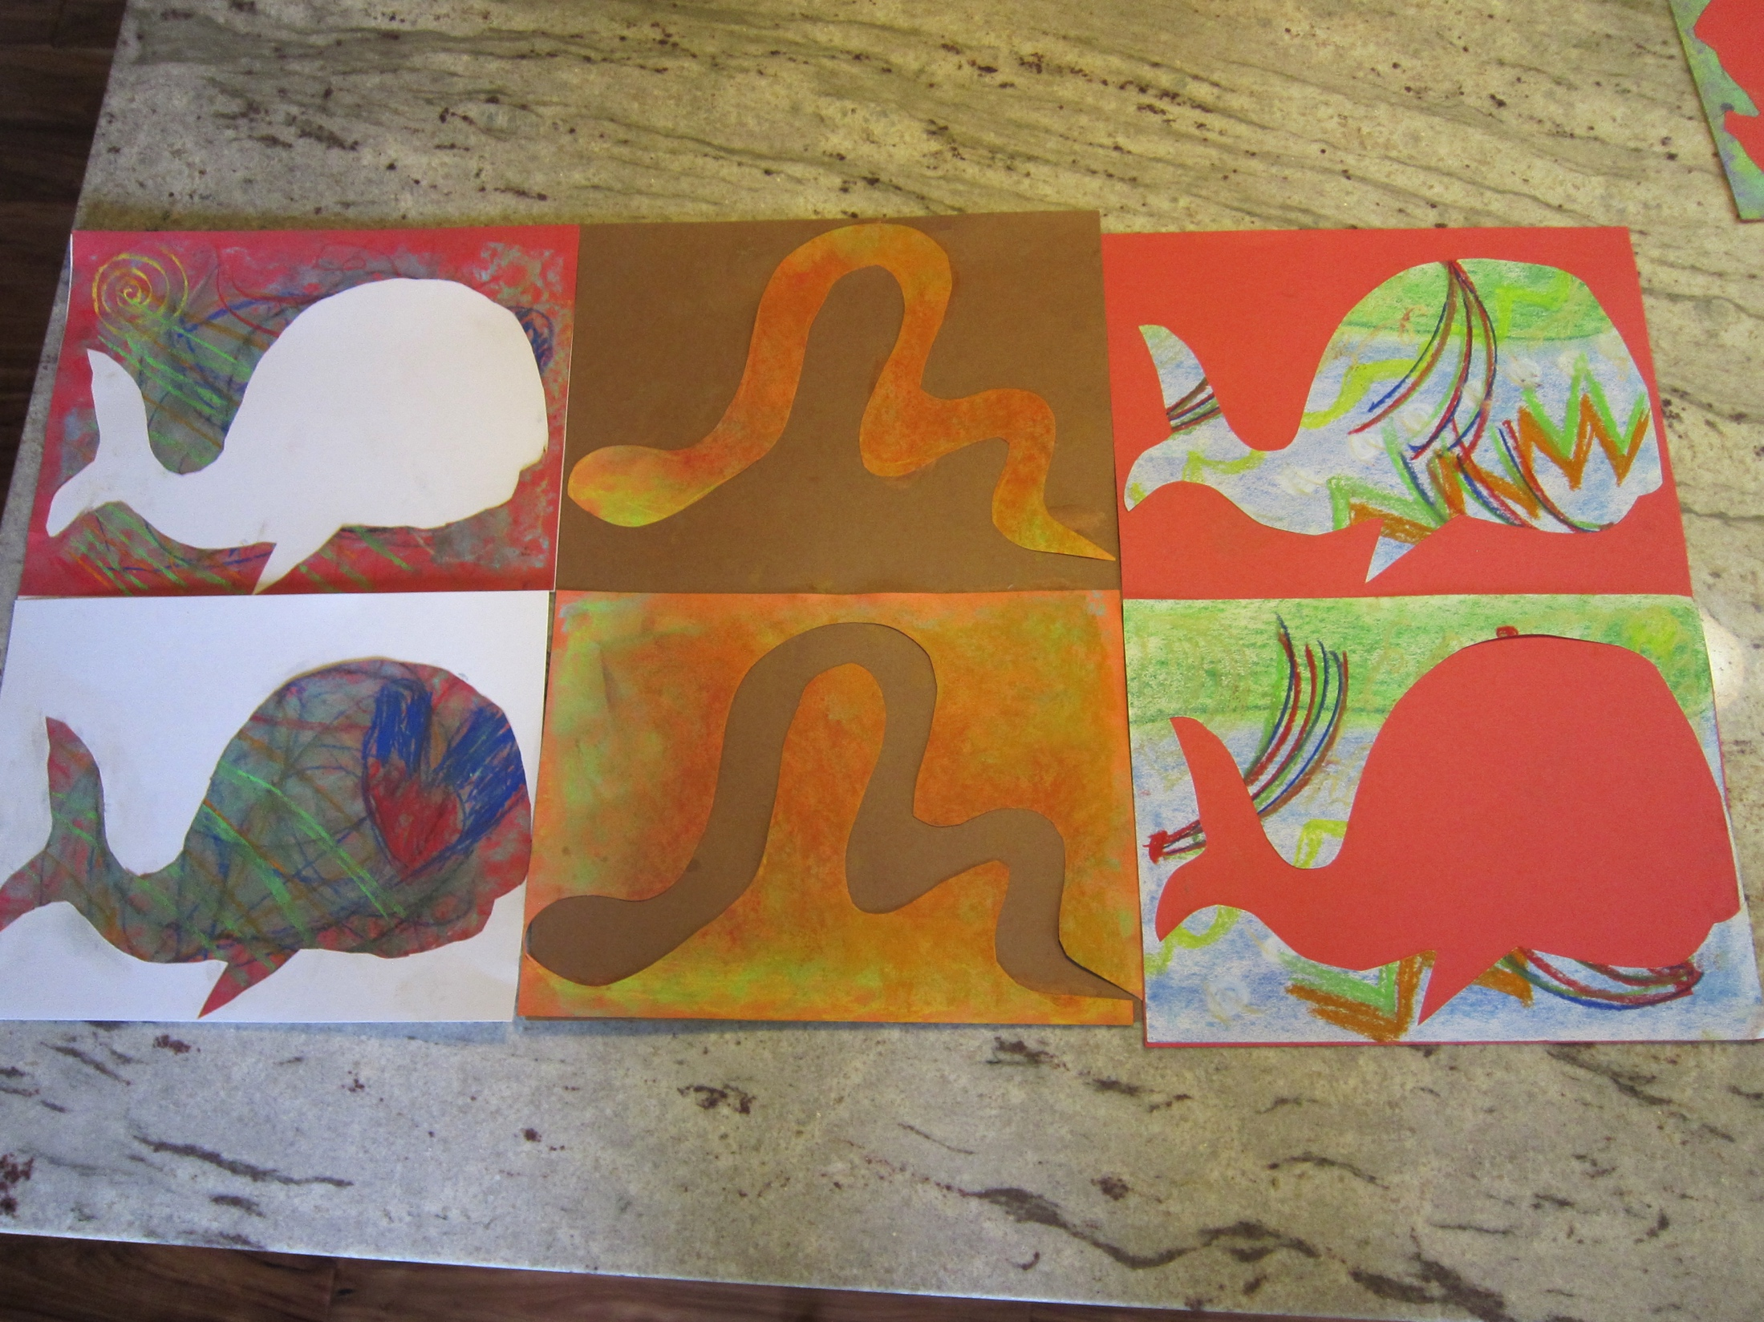
OUTSIDE IN!
INSIDE OUT!

Slide 18
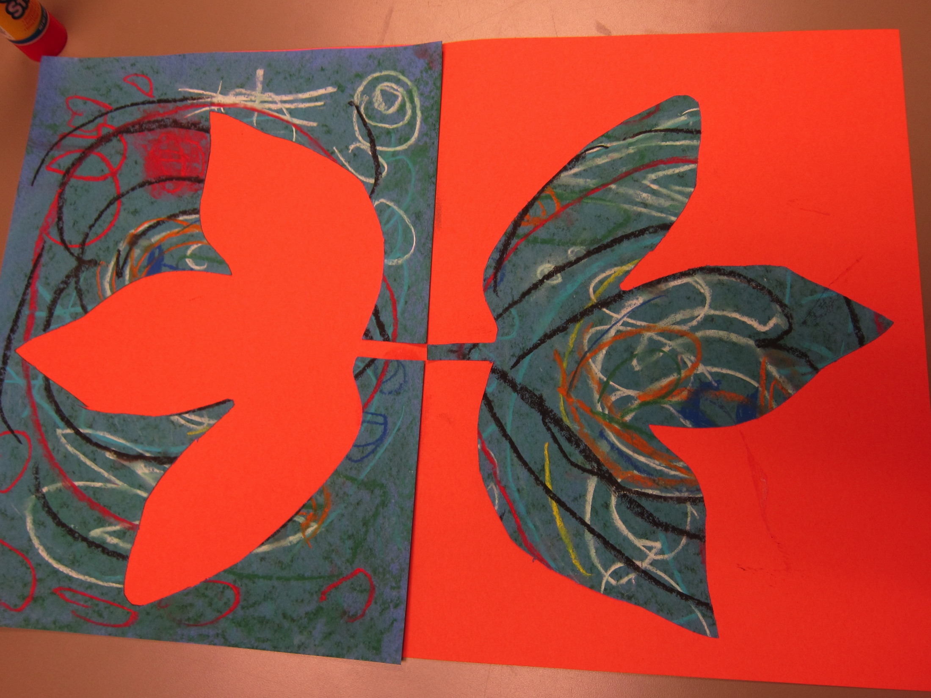
OUTSIDE IN!
INSIDE OUT!

